Slide 1

Datta Meghe College of Engineering
Department of computer engineering
Academic Year: 2022 -23
Monitoring Supply chain of pharmaceutical drugs using blockchain.
Group no. 12
Div | Roll no. | Group member name
A | 46 | Swapnil Umesh Karpe.
A | 59 | Vishal Kamlesh Mourya .
A | 65 | Marmik Dattaram Niwate.
Guide Name – Mr. S S Karve..

Slide 2
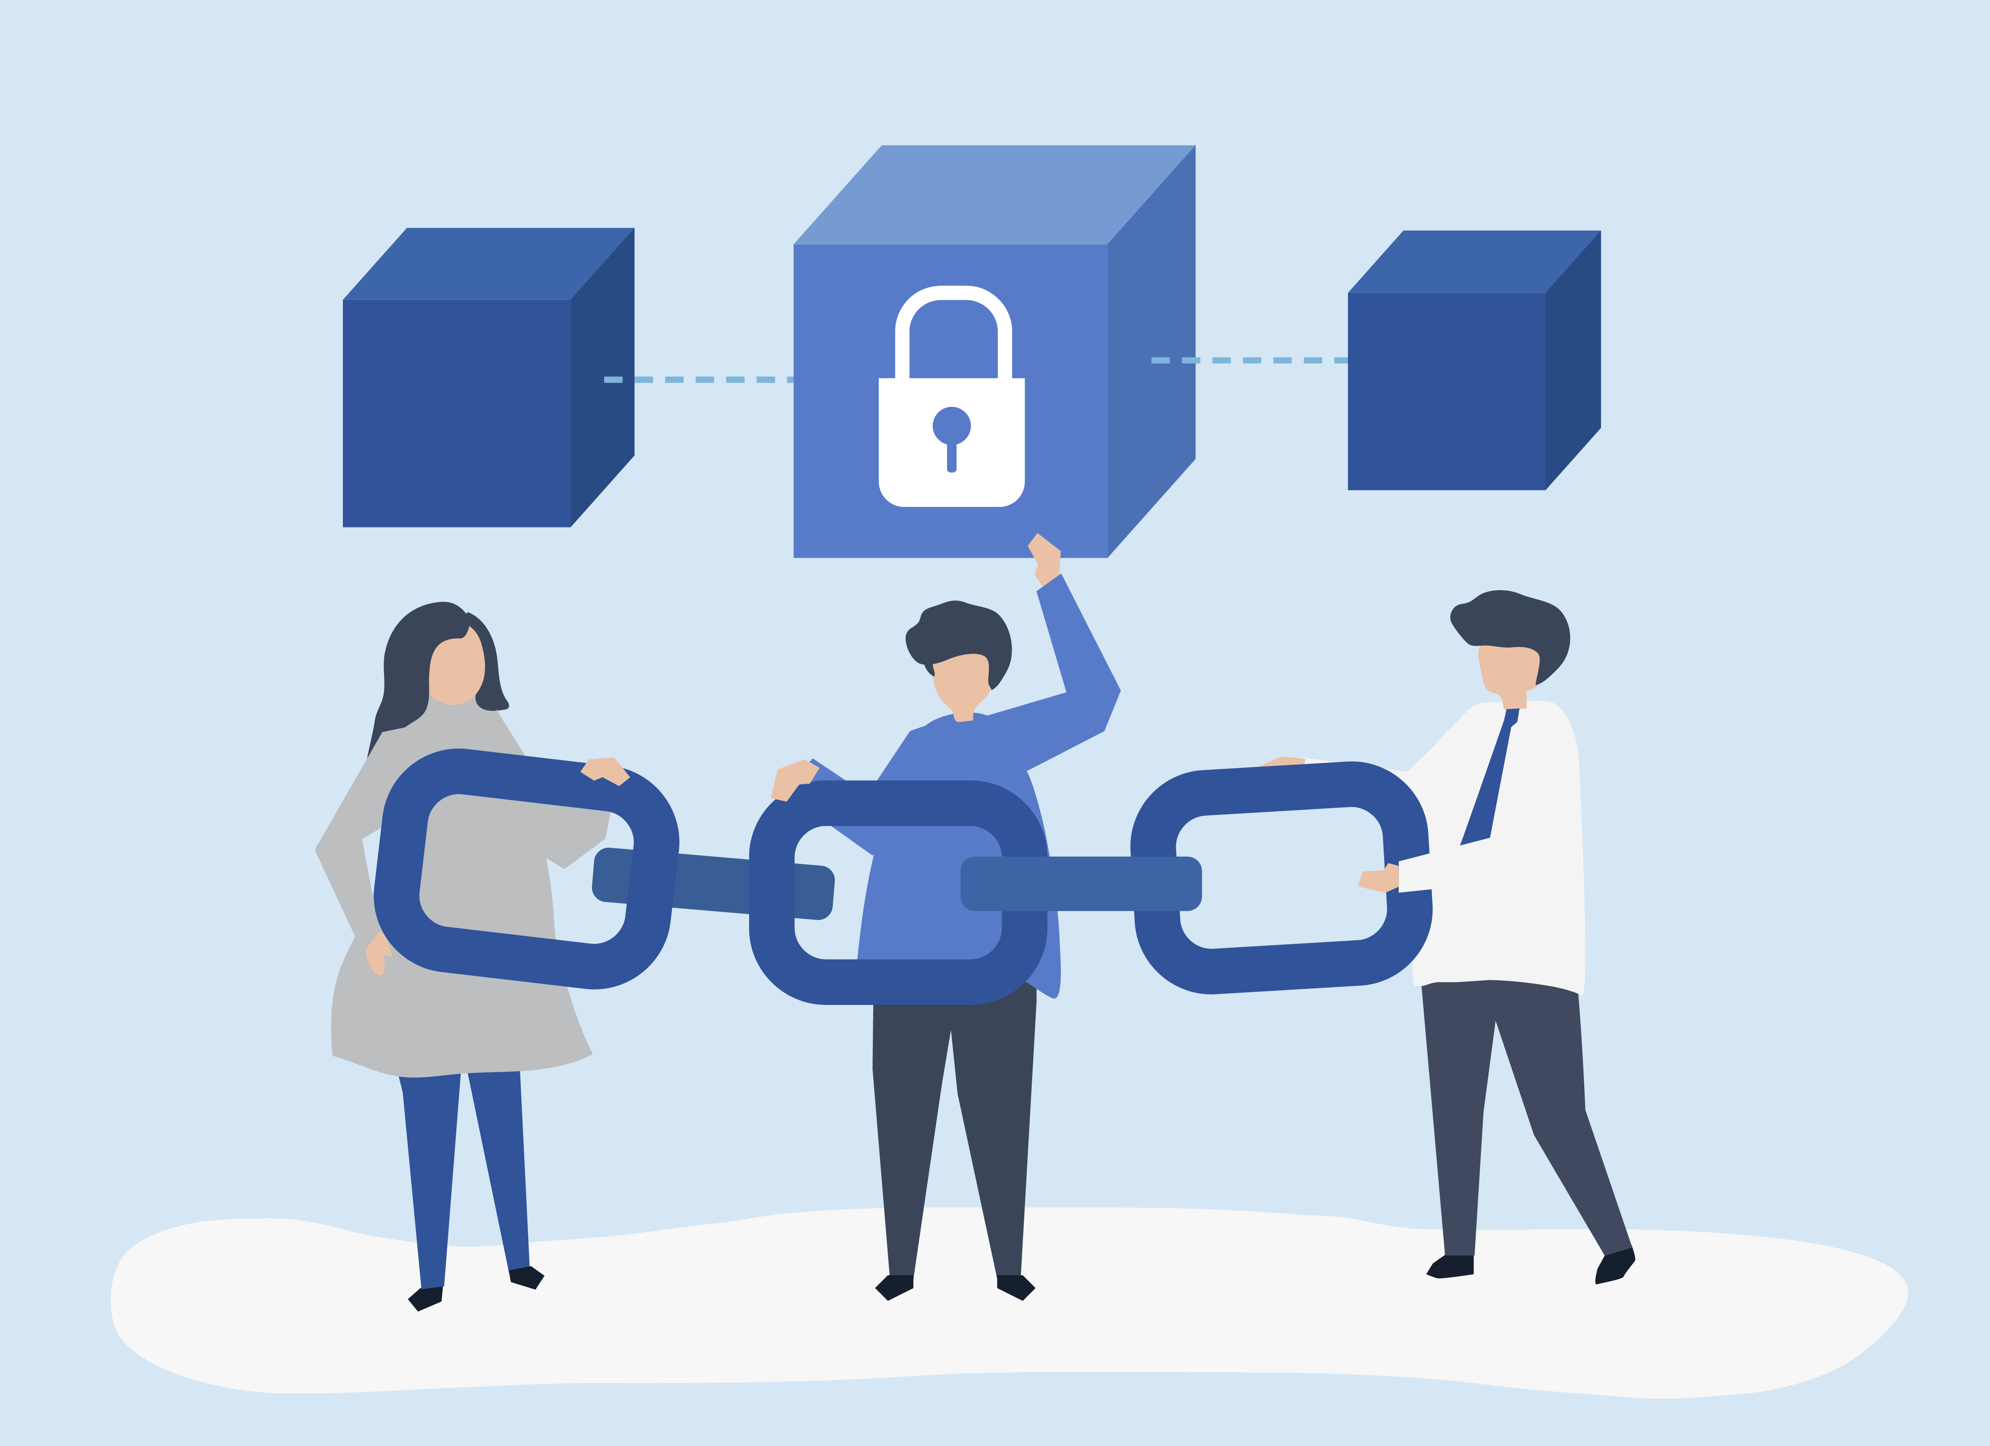
Introduction :-
The pharmaceutical supply chain network is a mechanism by which manufactured prescription medications are distributed to the patients.
• Tampering within the supply chain and counterfeit products pose a serious threat as it is difficult to investigate the true value of the medicine.
• Strong and elegant supply chains and a prompt customer service are the two key factors that define a successful logistic company.
• Therefore we propose a system which is an amalgamation of powerful technology- Blockchain which helps in solving the threat of counterfeit medicines.

Slide 3
Blockchain technology.
Greater Transparency
Increased Efficiency
Better Security
Improved Traceability
Cryptocurrencies
Banking usage

Slide 4
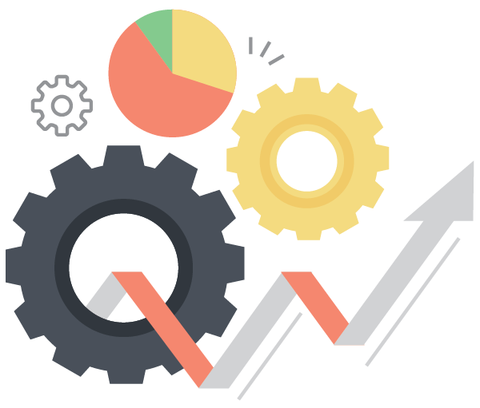
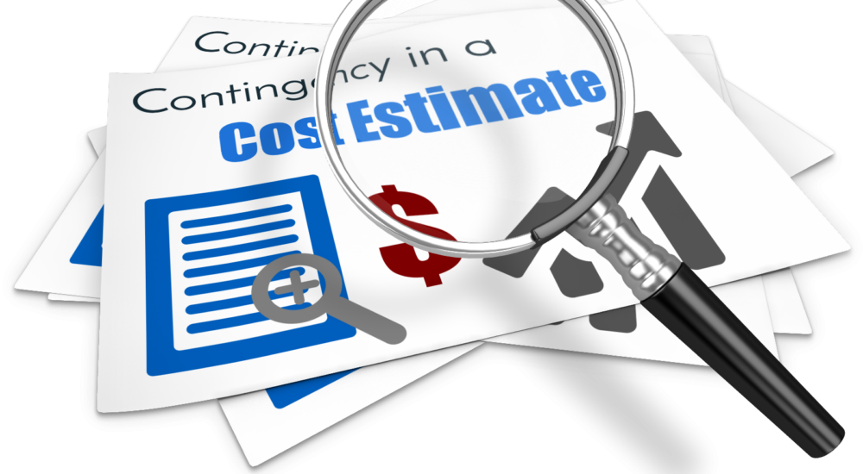
RESEARCH GAP
Lack of Implementation
Most of the papers only represented concepts in theory. In practically very few companies are trying to apply this methodology.
No Cost Estimation
Cost is important factor when it comes to decision of choosing a business model. Total cost estimation is not specified in the papers

Slide 5
In current scenario, there are certain problems :-
Shipment visibility
Slow process & prone paperwork
Mutable and invalid source
Lack of coordination
Problem Definition :-
To create a full fledge web application which manages the supply chain using blockchain instead of tradition centralized network.
Aim :-
1)The current centralized supply chain management systems are inefficient, lack transparency and trust, and result in higher costs and delays.
2)Developing a full-fledged web application that uses blockchain technology can solve these issues by providing a decentralized, transparent, and secure system for tracking and verifying transactions.
3)The challenges in developing such an application include designing a user-friendly interface, implementing a robust blockchain architecture, ensuring data privacy and security, and addressing regulatory and legal hurdles. The goal is to streamline the supply chain process, reduce costs, and enhance trust and transparency.
Problem Formulation :-

Slide 6

Objectives :-
Enhance the efficiency and transparency of the supply chain management process by developing a web application that leverages blockchain technology to provide a decentralized and secure system for tracking and verifying transactions.
Reduce costs and eliminate delays by streamlining the supply chain management process through the use of blockchain-based smart contracts, which can automate many of the tasks currently performed manually.

Slide 7
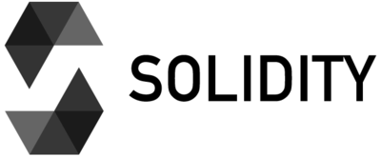

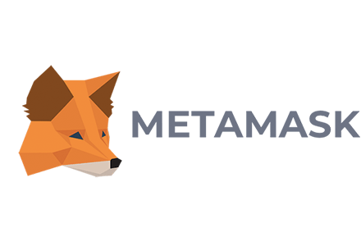
Technology / Softwares used -
Solidity Language.
Ganache.
MetaMask Wallet.

Slide 8
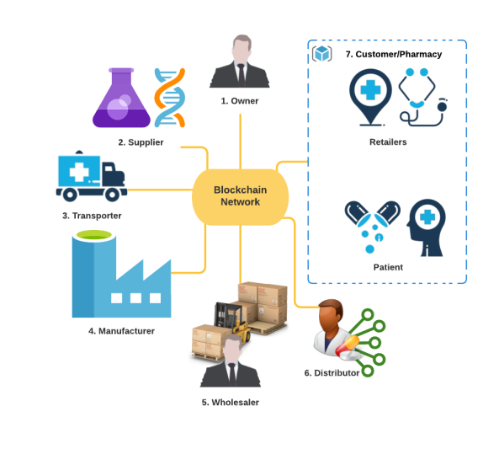
Proposed Method
The proposed methodology is going to resolve the problem faced in the earlier supply chain management starting from the first Entity i.e. Owner
1. Owner
2. Supplier
3. Transporter
4. Manufacturer
5. Wholesaler
6. Distributor

Slide 9
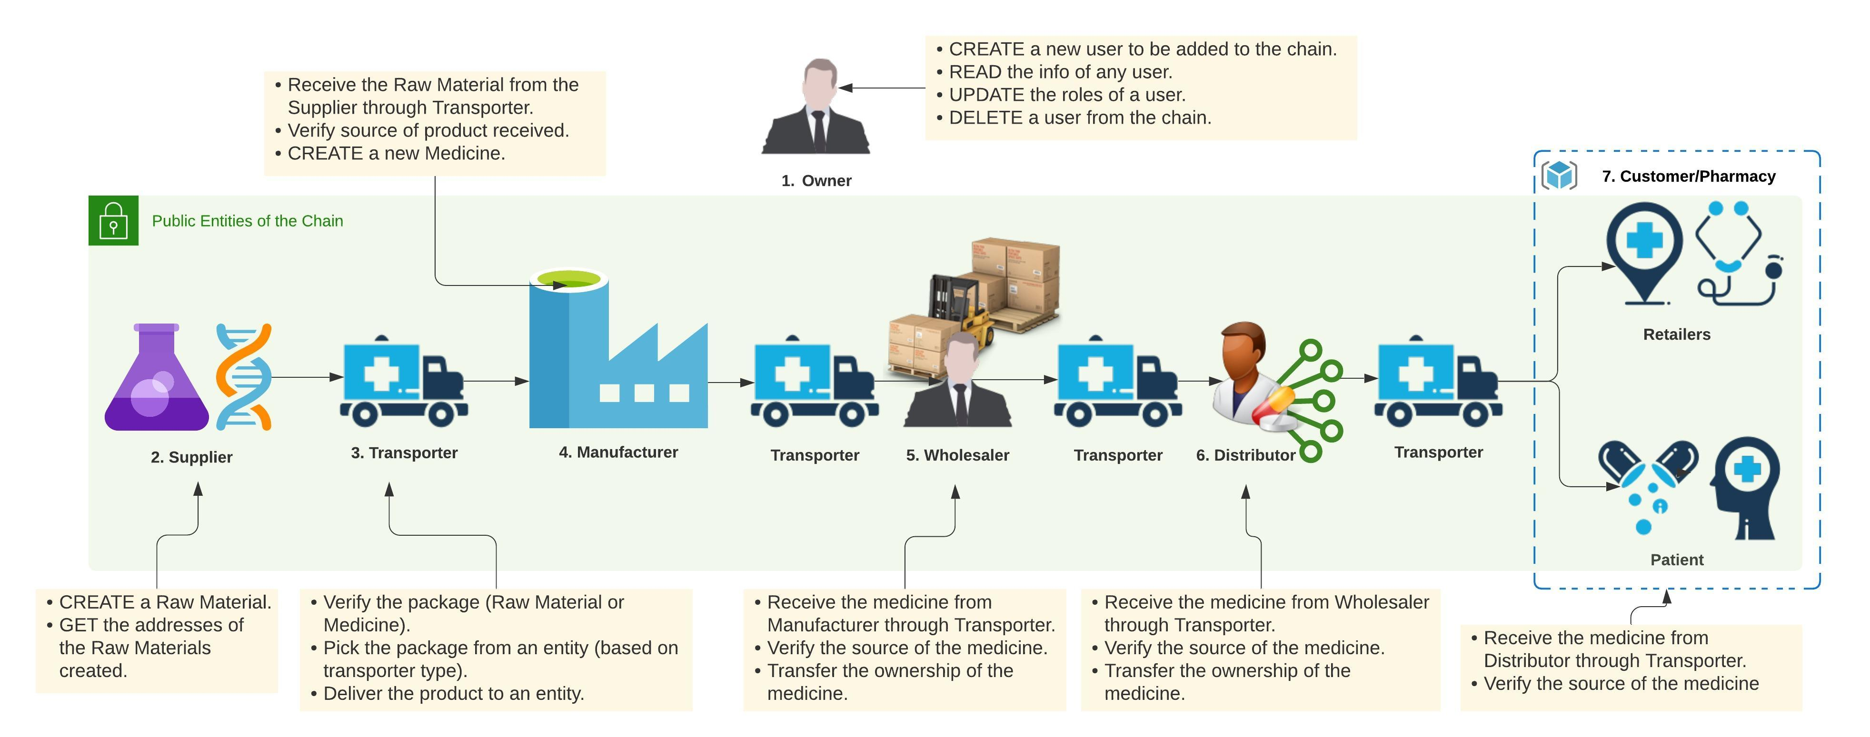
Techniques
Steps Involved
A

Slide 10
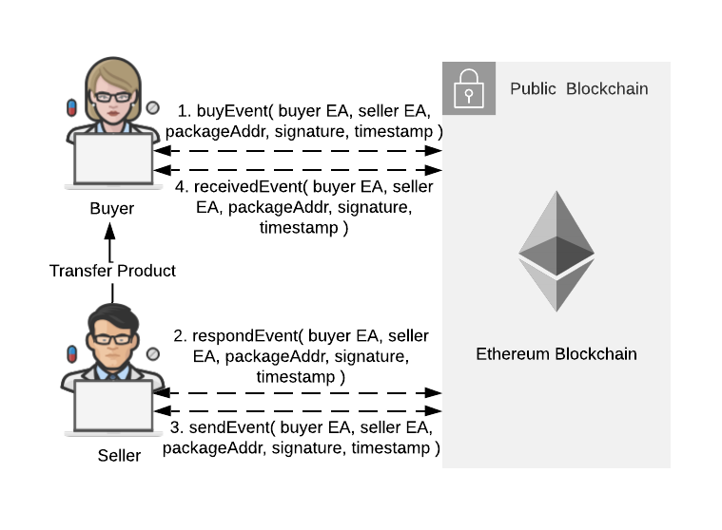

Techniques
Architecture
A

Slide 11

Conclusion
Here, we discussed how critical pharma industry is for human life and how it is on constant risk of fake products/drugs.
To overcome this shortcoming of the conventional supply chain management system of the pharma industry, we can use blockchain. Currently, it is the only platform available that can offer such a great security feature .
Blockchain seems to have very promising future due to the features that it offers.
It can be seen that blockchain has the solution to many of the problems that IT industry is facing like security And not only IT industry, various other industries such as pharma as we discussed here or banking sector are also facing issues like security and transparency.
And as we see, many industries are already shifting their conventional platform to blockchain.

Slide 12
Reference
Application of blockchain and iot towards pharmaceutical industry
A Premkumar, C Srimathi - 2020 6th International Conference …, 2020 - ieeexplore.ieee.org
2) Applications of blockchain technology in medicine and healthcare: Challenges and future perspectives
AA Siyal, AZ Junejo, M Zawish, K Ahmed, A Khalil… - Cryptography, 2019
3) The Use of Blockchain Technology in the Health Care Sector: Systematic Review
D Elangovan, CS Long, FS Bakrin, CS Tan… - JMIR medical …, 2022
4) Blockchain Medledger: Hyperledger fabric enabled drug traceability system for counterfeit drugs in pharmaceutical industry
M Uddin - International Journal of Pharmaceutics, 2021 – Elsevier
5) Blockchain in supply chain management: a review, bibliometric, and network analysis
J Moosavi, LM Naeni, AM Fathollahi-Fard… - … and Pollution Research, 2021 – Springer
6) Applying blockchain in the modern supply chain management: Its implication on open innovation
M Teodorescu, E Korchagina - Journal of Open Innovation: Technology …, 2021 - mdpi.com

Slide 13
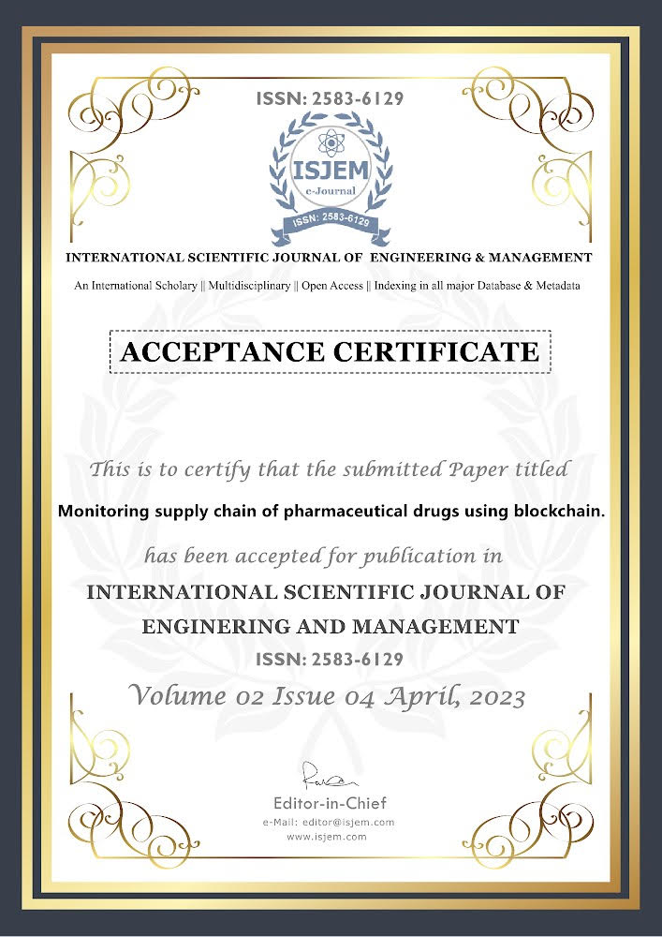
Our publication

Slide 14
Thank You
.

